Slide 1
PROJECT TITLE: Anomaly Detection in Credit Card Transactions
CSE2026 - Data Handling and Visualization
Review0/1
Batch: 8ISE2
Reviewer: Mrs. Poornima
Roll Number | Student Name
20201ISE0088 20201ISE0089 20201ISE0065 | Gaurav Kumar Ankit Kumar Natraj S

Slide 2
Introduction
Credit card fraud is a significant problem in the financial industry, causing substantial financial losses and eroding consumer trust. Anomaly detection in credit card transactions aims to identify unusual patterns that may indicate fraudulent activity. By leveraging advanced machine learning techniques and statistical analysis, we can enhance the security of credit card transactions, thereby protecting consumers and financial institutions from potential fraud.

Slide 3
Motivation
The motivation behind anomaly detection in credit card transactions is driven by several factors:
Financial Losses: Credit card fraud results in billions of dollars in losses annually. Reducing these losses is a primary concern for financial institutions.
Customer Trust: Ensuring the security of transactions helps maintain and improve customer trust and satisfaction.
Regulatory Compliance: Financial institutions are required to adhere to regulations and standards that mandate the protection of consumer data and the implementation of fraud detection measures.
Technological Advancements: Advances in machine learning and data analytics provide new opportunities to enhance the accuracy and efficiency of fraud detection systems.

Slide 4
Objectives
The objective of the project is to detect anomalies in credit card transactions. To be prcise, given the data on Time, Amount and transformed features V1 to V28, our goal is to fit a probability distribution based on authentic transactions, and then use it to correctly identify a new transaction as authentic or fraudulent. Note that the target variable plays no role in constructing the probability distribution.

Slide 5
Methodology
The methodology for anomaly detection in credit card transactions typically involves the following steps:
Data Collection: Gather transaction data, including details such as transaction amount, time, location, and merchant information. Historical data labeled as fraudulent or legitimate is also collected.
Data Preprocessing: Clean and preprocess the data to handle missing values, normalize features, and encode categorical variables. This step may also involve feature engineering to create new relevant features.
Exploratory Data Analysis (EDA): Perform EDA to understand the data distribution, identify patterns, and detect any anomalies in the dataset.

Slide 6
Visualization Techniques
Visualization plays a crucial role in understanding the data and the results of the anomaly detection models. Common visualization techniques include:
Histograms and Box Plots: Used for visualizing the distribution of transaction amounts and other numerical features.
Scatter Plots: Helpful for identifying correlations between different features and spotting outliers.
Heatmaps: Show the correlation matrix between features, aiding in feature selection.
Time Series Plots: Visualize transaction patterns over time to detect anomalies in the temporal domain.

Slide 7
Visualization Techniques
Receiver Operating Characteristic (ROC) Curve: Used to evaluate the performance of classification models, illustrating the trade-off between true positive rate and false positive rate.
Confusion Matrix: Provides a detailed breakdown of model performance by showing true positives, true negatives, false positives, and false negatives.
Cluster Plots: Visualize the results of clustering algorithms, helping to identify distinct groups of transactions and potential anomalies.

Slide 8
Train-Validation-Test Split
For anomaly detection, we build the classification model based on the authentic transactions only. Thus, the training set will consist entirely of authentic transactions. The validation set and the test set will have both authentic transactions and fraudulent transactions.
We split the dataset in the following way:
Training set → 80% observations from the authentic class
Validation set → 10% observations from the authentic class + 50% observations from the fraudulent class
Test set → 10% observations from the authentic class + 50% observations from the fraudulent class
We show the distribution of authentic and fraudulent transactions over training, validation, and test set.

Slide 9
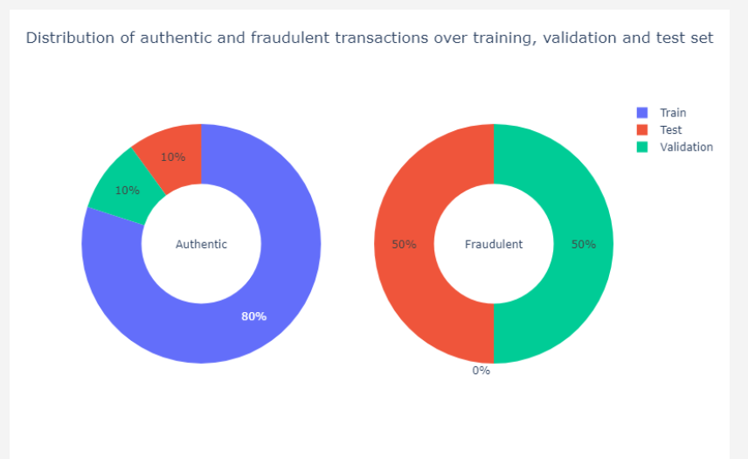
Train-Validation-Test Split

Slide 10
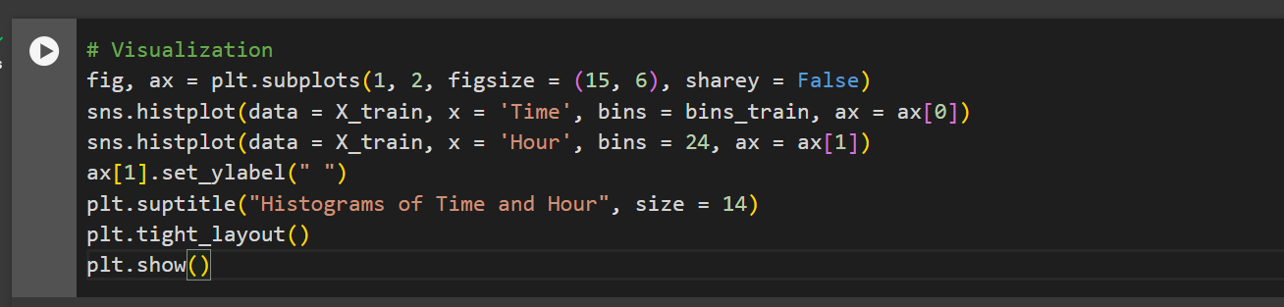
Visualizations

Slide 11
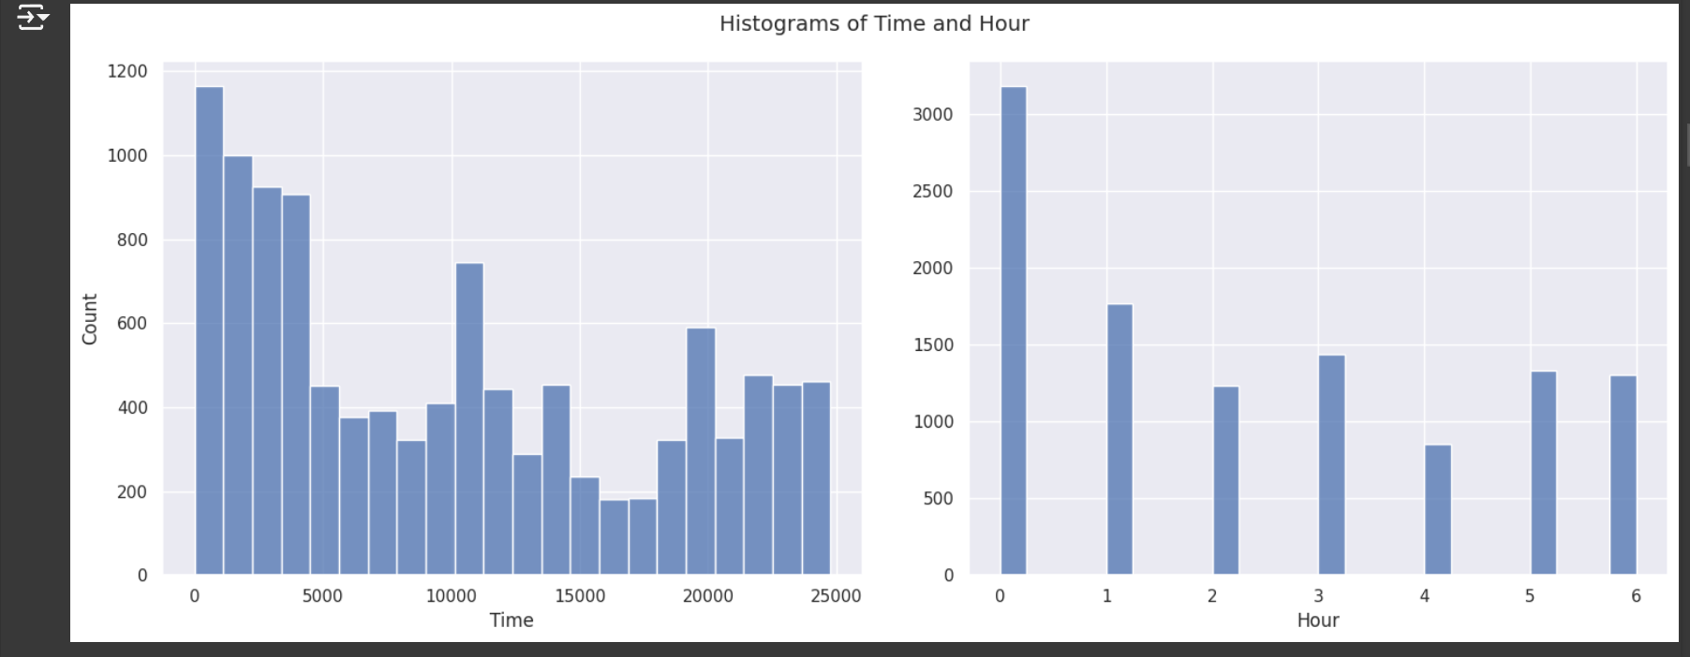
Visualizations
Training and Validation: Split the data into training and validation sets. Train the chosen models on the training set and validate their performance using the validation set.
Evaluation Metrics: Evaluate the models using metrics such as accuracy, precision, recall, F1-score, and Area Under the Receiver Operating Characteristic Curve (AUC-ROC).
Model Tuning: Fine-tune the models based on evaluation results to improve performance.
Deployment: Implement the final model into the transaction processing system for real-time anomaly detection.

Slide 12
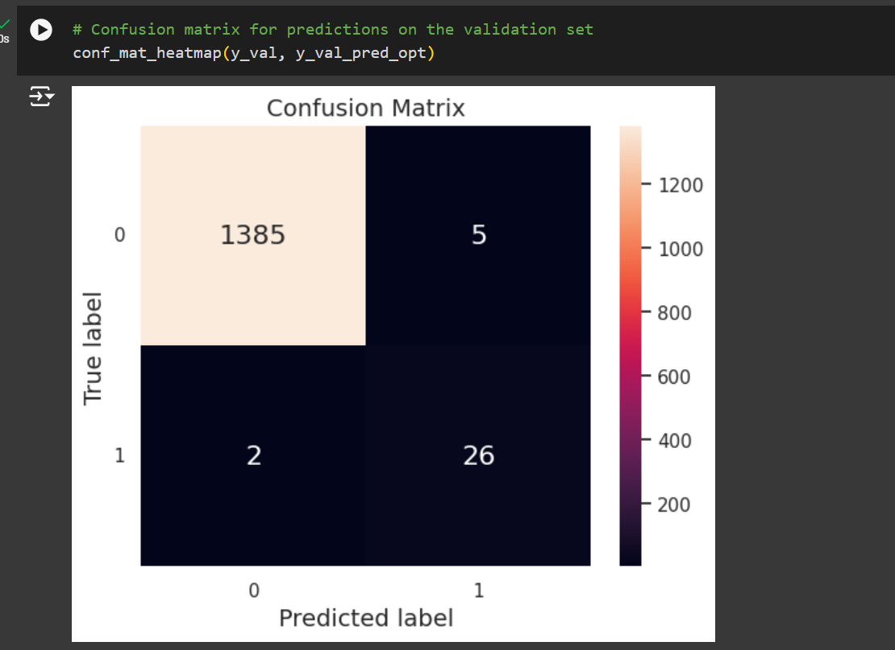
Heat Map

Slide 13
Conclusion
Anomaly detection in credit card transactions is a critical component of modern fraud detection systems. By leveraging advanced machine learning techniques and comprehensive data analysis, financial institutions can significantly reduce fraudulent activities, protect consumers, and ensure compliance with regulatory standards. Visualization techniques further aid in understanding and interpreting the results, making the entire process more transparent and effective.

Slide 14
Thank You

